Slide 1
Cytogenetics and genome analysis

Slide 2
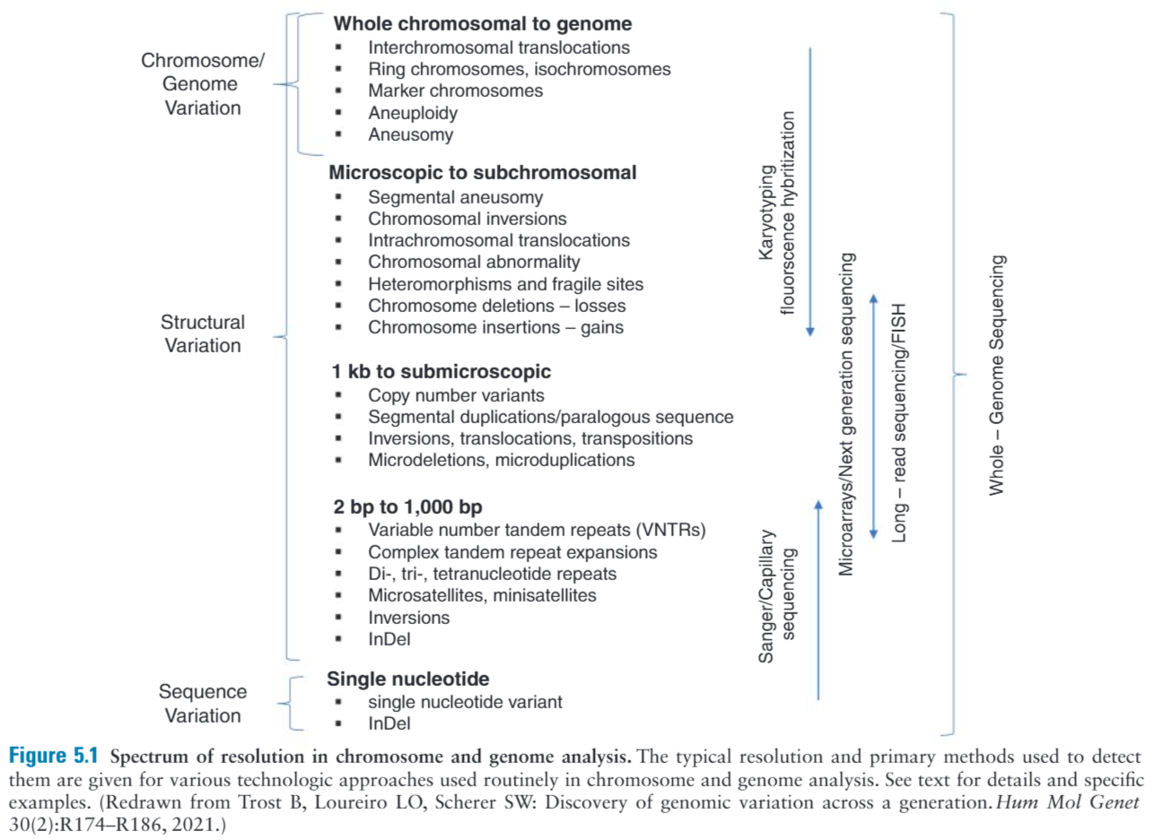

Slide 3
Cytogenetic abnormalities are present in:
1% of live births
2% of pregnancies in women >35 who undergo prenatal diagnosis
50% of all spontaneous first trimester abortions

Slide 4
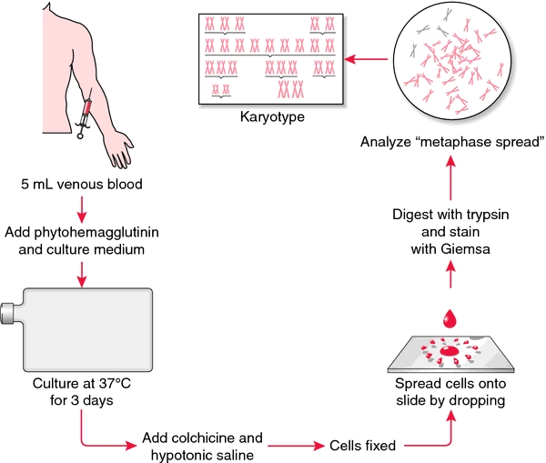
Chromosome analysis
Cells must be capable of proliferation in culture
Most accessible cells are white blood cells
Cells are stimulated to divide
Arrested in metaphase with chemicals inhibiting mitotic spindle
Treated with hypotonic solution to release chromosomes
Chromosomes are fixed, spread on slides, and stained

Slide 5
Clinical indications for chromosome and genome analysis:
Problems of early growth and development
Stillbirth and neonatal death
incidence of chr abn in stillbirth and neonatal deaths is 10% compared to 1% in live births
Fertility problems
Chr abn is found in 3-6% of infertility
Family history
Neoplasia
Pregnancy
For woman older than 35

Slide 6
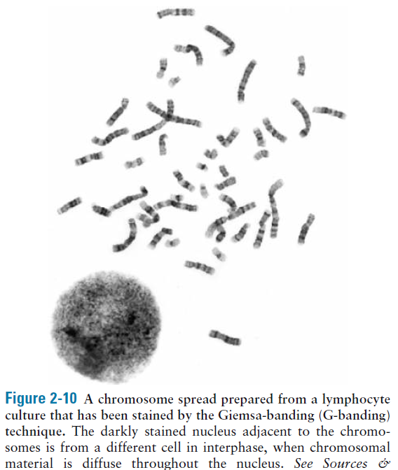
G banding

Slide 7
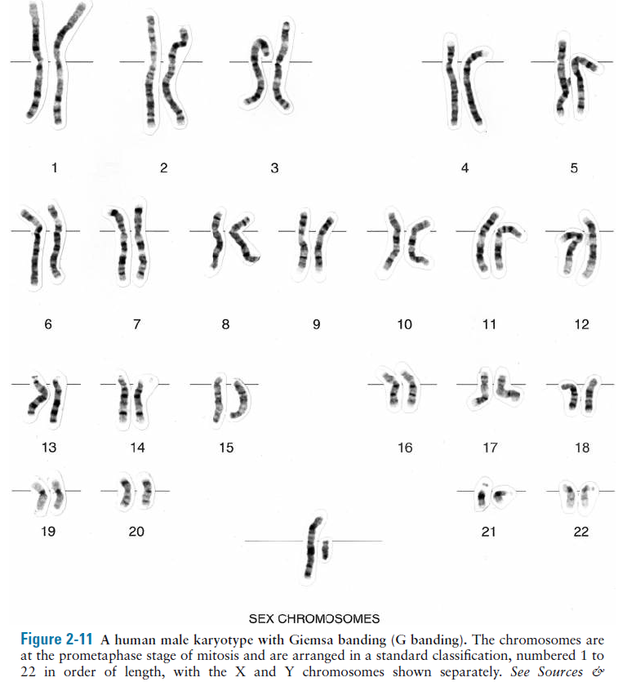
karyotype

Slide 8
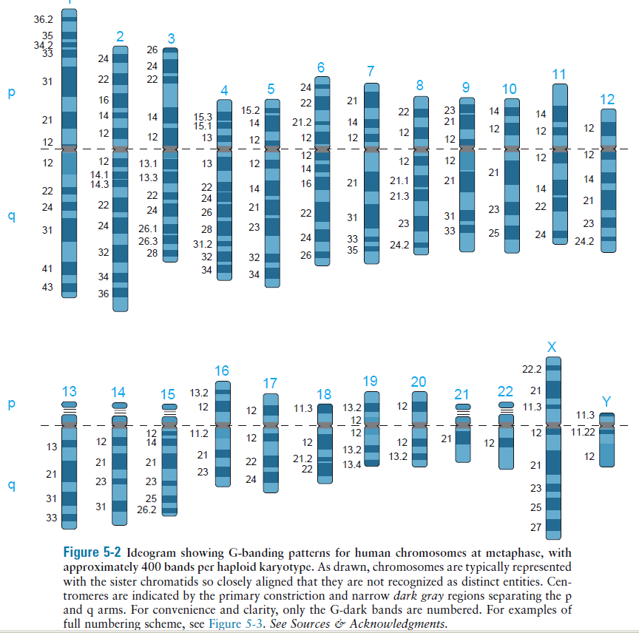

Slide 9
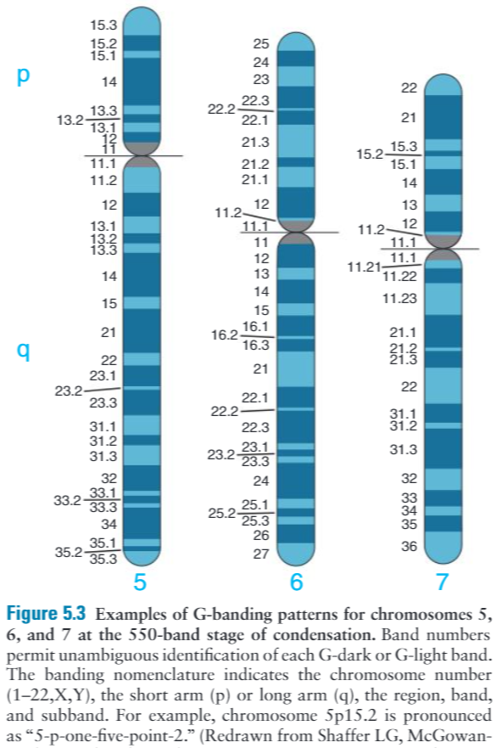

Slide 10
Metacentric
Submetacentric
Acrocentric satellites
Telocentric
Fragile sites: nonstaining gaps, prone to genomic insatiability
e.g. Fragile X

Slide 11
Standard G-banded karyotype is at 400-550 band resolution, metaphase
More sensitivity and resolution can be obtained at 850 band utilizing prometaphase chromosomes

Slide 12
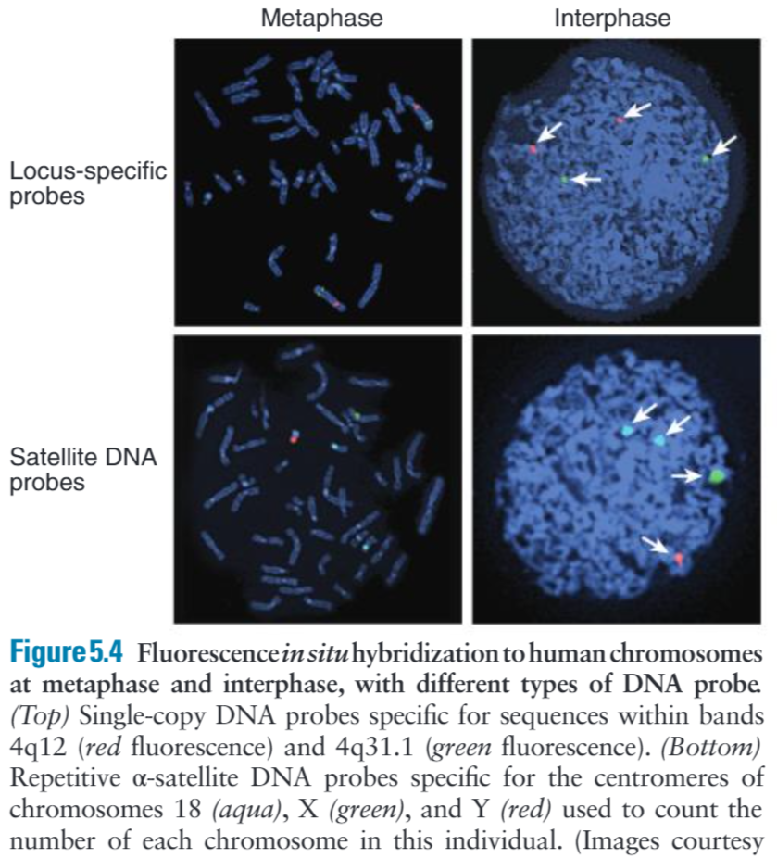
Fluorescence in situ hybridization (FISH)
Does not allow for efficient analysis of the entire genome
>> its use is limited by the need to target a specific genomic region based on a clinical diagnosis or suspicion

Slide 13
MLPA

Slide 14
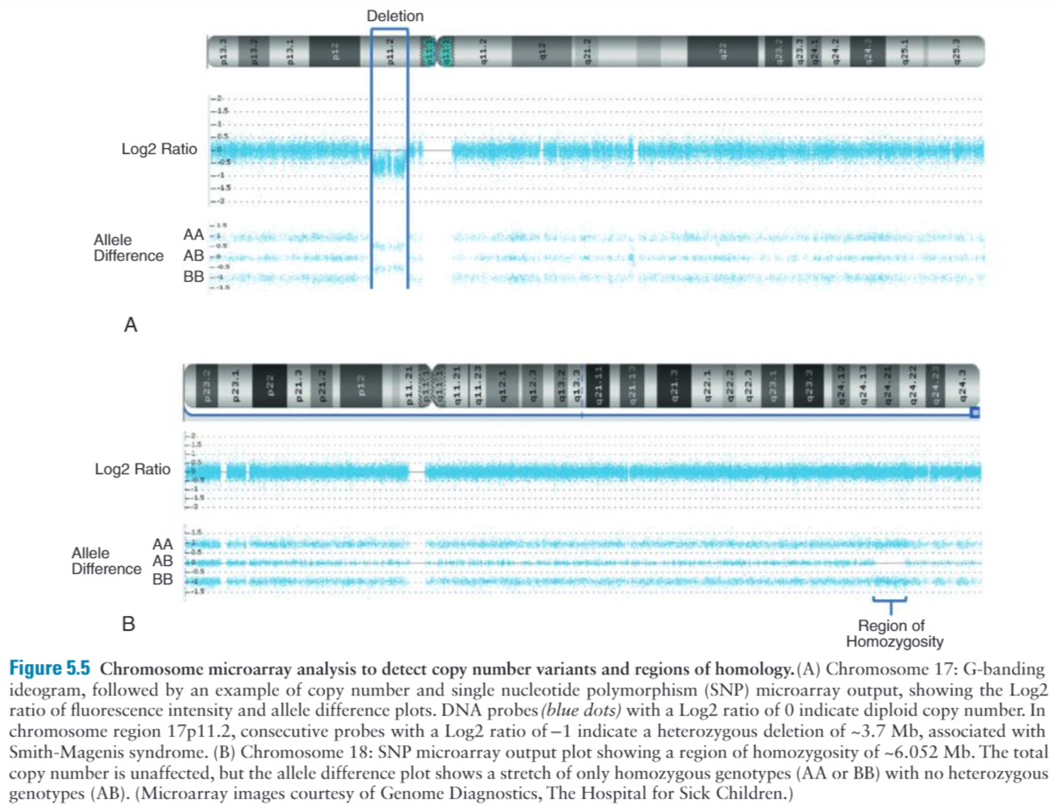

Slide 15
Two main limitations of microarrays:
Measure only the relative copy number of DNA, not translocations or balanced rearrangements
Can reveal differences of copy number that are of uncertain clinical significance which may turn out to be benign

Slide 16
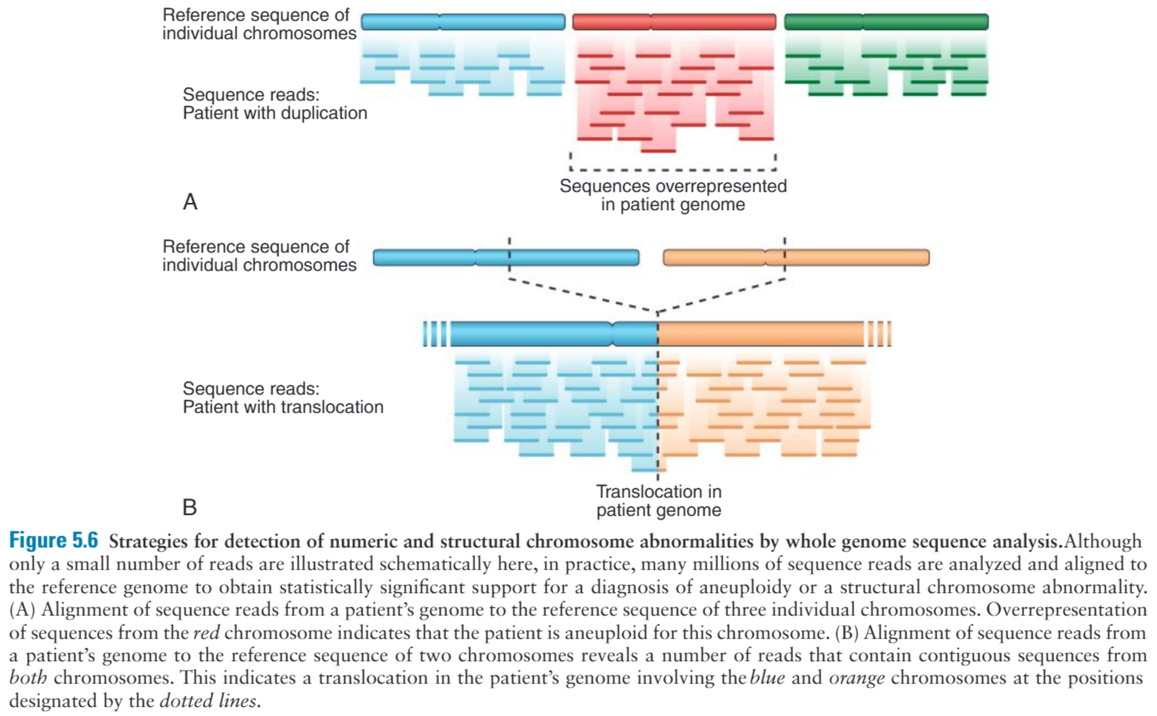

Slide 17
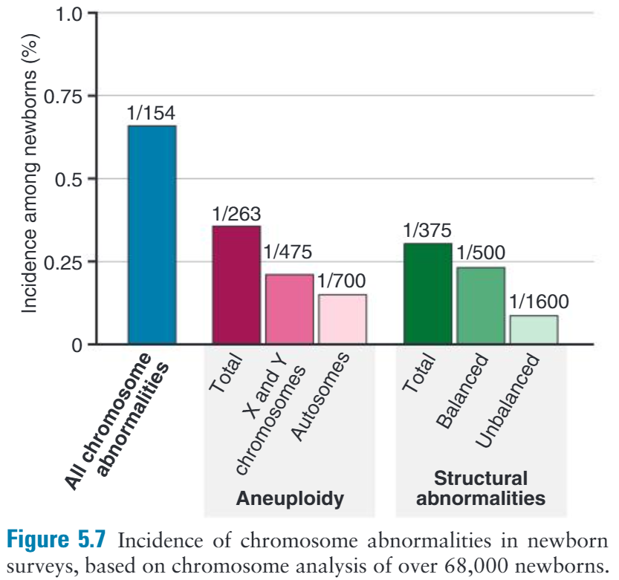

Slide 18
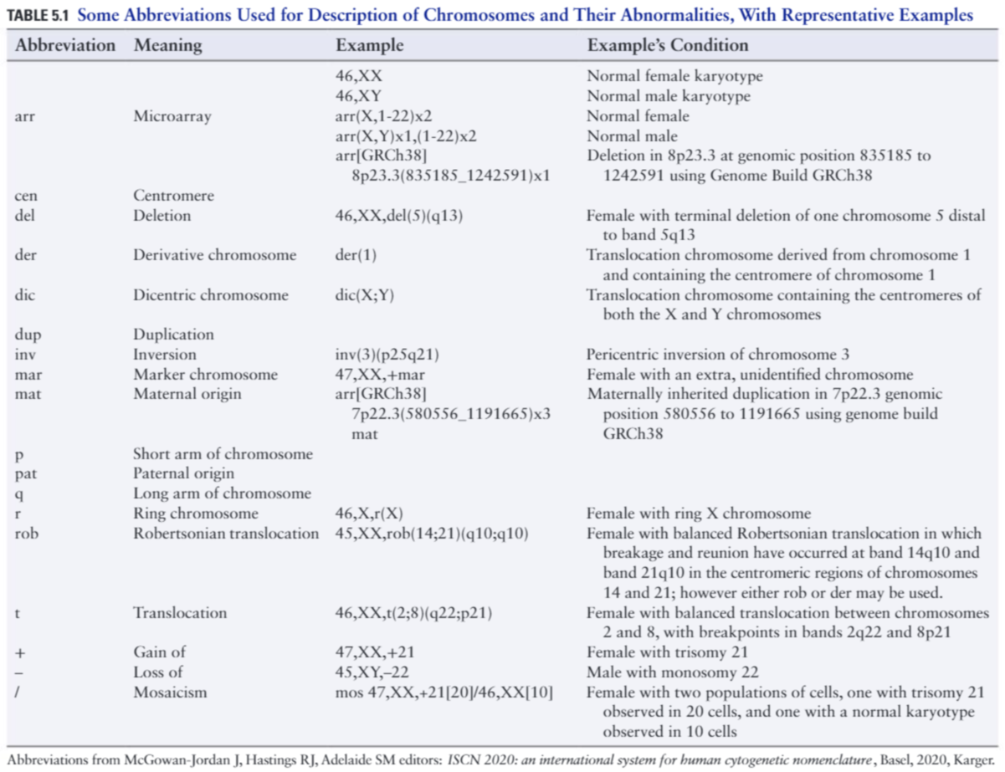

Slide 19
Gene Dosage, Balance and Imbalance
For chromosome and genomic disorders, it is the quantitative aspects of gene expression that underlie disease, in contrast to single-gene disorders, in which pathogenesis often reflects qualitative aspects of a gene’s function

Slide 20
Abnormalities of Chromosome Number
Heteroploid: a human chromosome complement with any number other than 46
Euploid: an exact multiple of the haploid chromosome number (n)
diploid, triploid, tetraploid
Triploid: if extra set from mother then aborted spontaneously
if extra set from father then abnormal degenerative placenta (partial hydatidiform mole) with a small fetus
Tetraploid: failure of completion of an early cleavage division
Aneuploid: any other chromosome number
trisomy, monosomy
trisomy 21 (Down syndrome,47,XX,+21), trisomy 13, 18
Monosomy X (Turner syndrome)
Klinefelter syndrome XXY

Slide 21
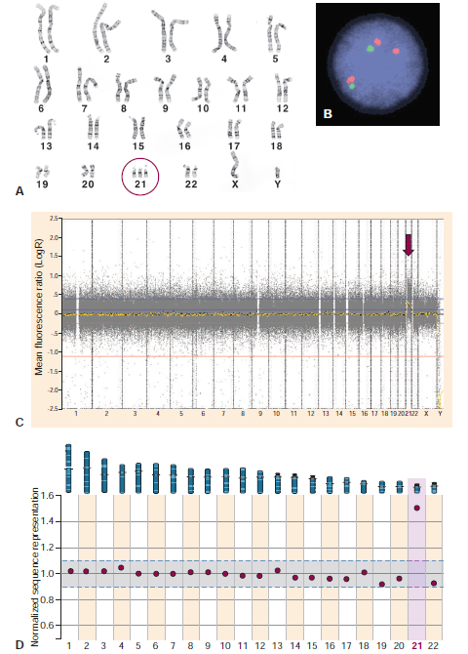
Figure 5-8 Chromosomal and genomic approaches to the diagnosis of trisomy 21.
Karyotype
Interphase FISH
Whole-genome chromosomal microarray
Whole-genome sequencing

Slide 22
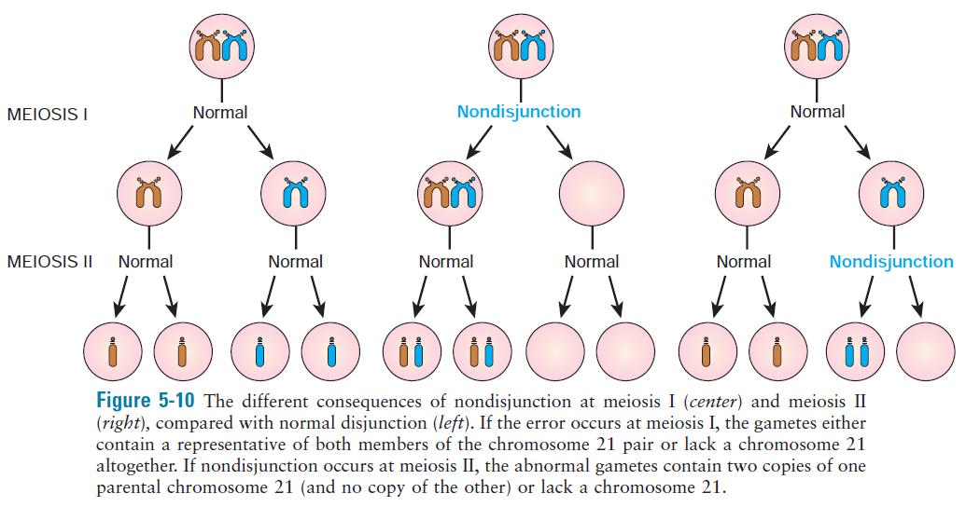
Meiotic nondisjunction
5-9

Slide 23
Abnormalities of Chromosome Structure
Unbalanced: there is additional or missing material
Deletion (partial monosomy), haploinsufficiency
Duplication (partial trisomy), appears less harmful
Ring chromosomes
Isochromosomes
Balanced: has the normal complement of chromosomal material
Translocations
Reciprocal
Robertsonian
Inversions

Slide 24
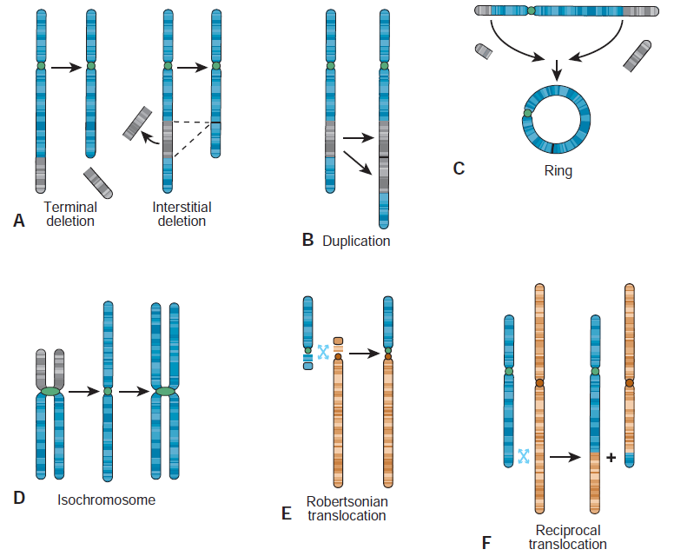
Figure 5-10 Structural rearrangements of chromosomes

Slide 25
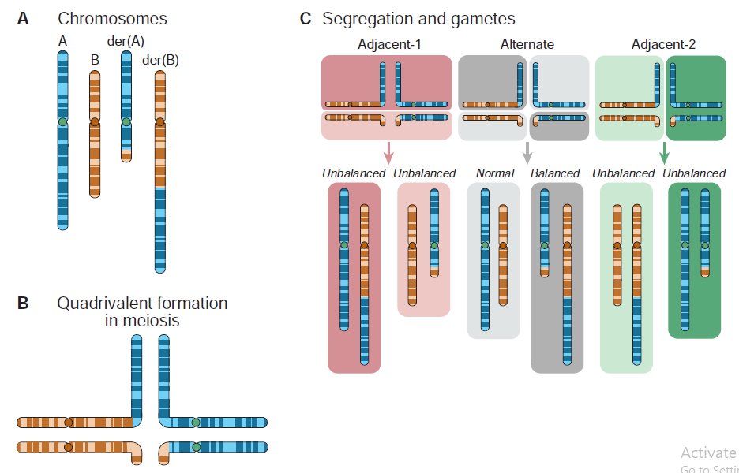
Figure 5-11
A, Diagram illustrating balanced translocation
B, Formation of quadrivalent in meiosis
C, Patterns of segregation in a translocation carrier

Slide 26
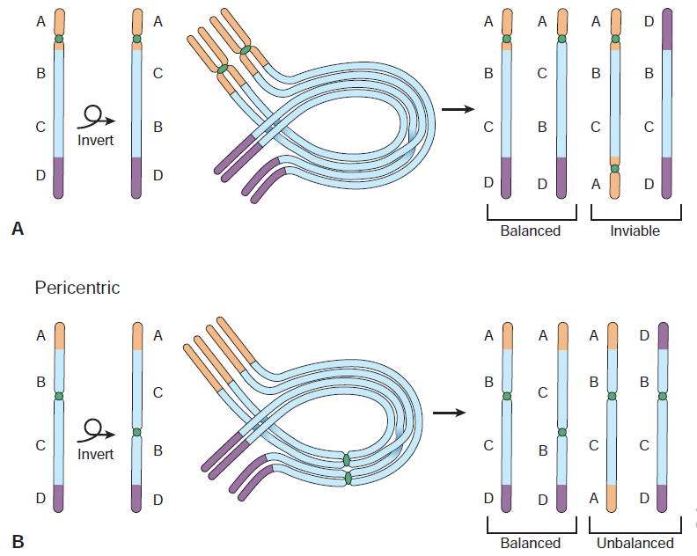
Paracentric
Pericentric
Figure 5-12 Crossing over within inversion loops formed at meiosis I

Slide 27
Mosaicism

